Slide 1
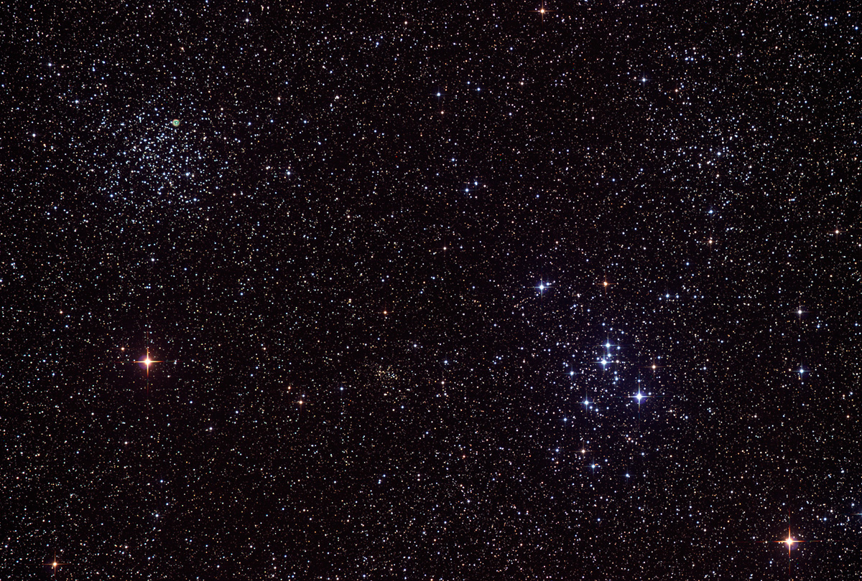

Howard
Astronomical
League
13
May 16, 2013

Slide 2
Upcoming club activities

Slide 3
Public outreach
June 9th – Howard County STEM Festival
1-4 PM, Howard County Community College, Duncan Hall

Slide 4
Star Parties!
May 18th – Public Star Party
(Girl Scout Troop and Middle School Science class)
June 1st – Members only Star Party
June 15th – Public Star Party

Slide 5
Stumper Question

Slide 6
How embarrassing is it that I messed up last month’s stumper question?
Notes:
There are not, in fact, more than 4,000 naked eye visible asteroids. Turns out I was deceived by data in the Minor Planet Center’s database that had been contributed by WISE, the Wide Field Infrared Explorer, and for which the magnitudes were in the infrared.

Slide 7
Answer:
Extremely

Slide 8
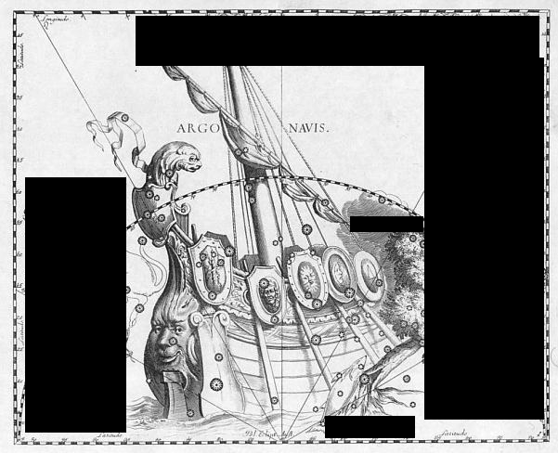
Notes:
This is a drawing of the constellation Argo Navis by Johannes Hevelius, from his work Uranographia. Argo Navis was devised by Ptolemy in the 2nd century AD, and If it existed today, it would be, by far, the largest constellation in the sky. In 1752, the French astronomer Nicolas Louis de Lacaille decided it was too unwieldy and large, and divided it into three constellations.

Slide 9
Nicolas Louis de Lacaille divided Argo Navis into three constellations.
Name them.

Slide 10
Dr. K.T. Ramesh
Impact and fragmentation of asteroids

Slide 11
Joe Bohanon
Kitt Peak Advanced Observer Program

Slide 12
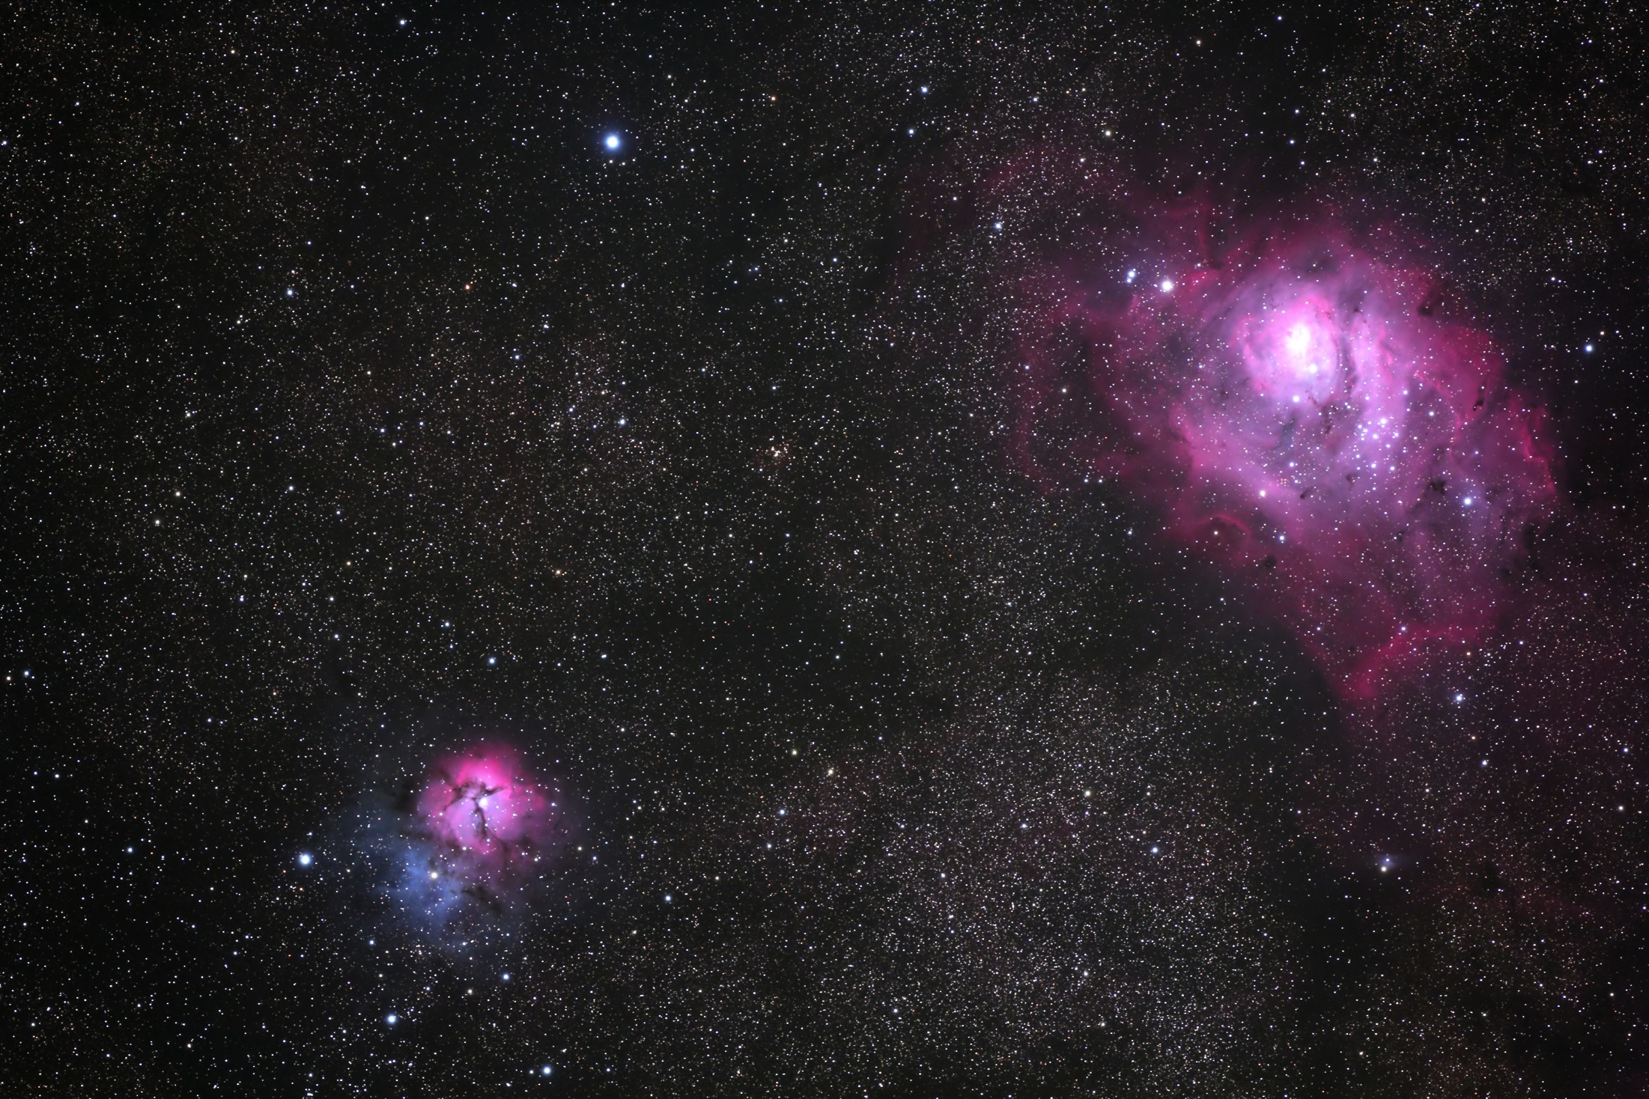

Slide 13
HAL on WBAL with Ava Marie
Notes:
Breakout to show video

Slide 14
Member’s astrophotos and sketches

Slide 15
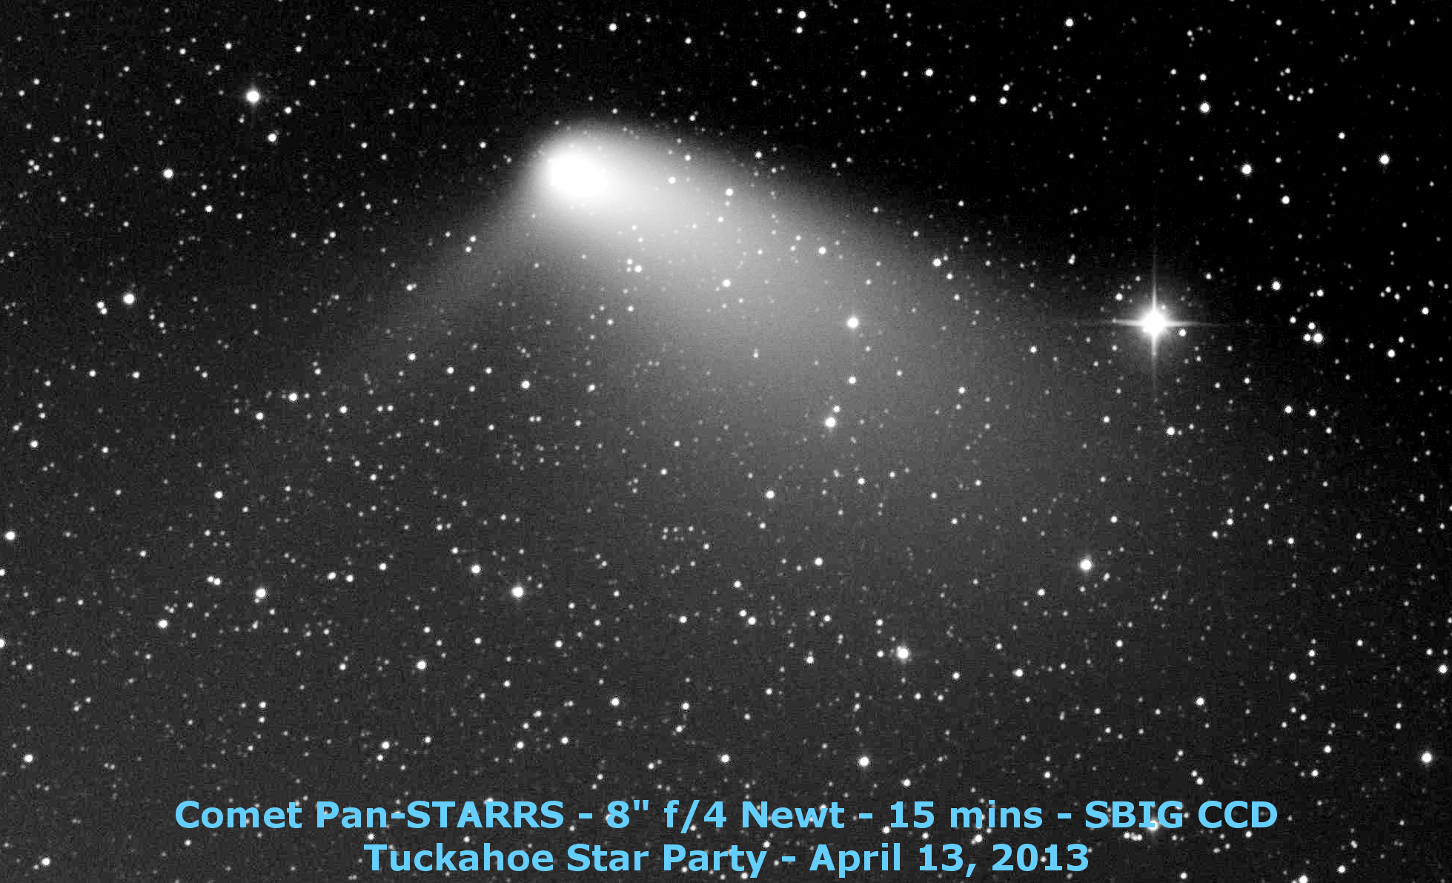
Gene Handler

Slide 16
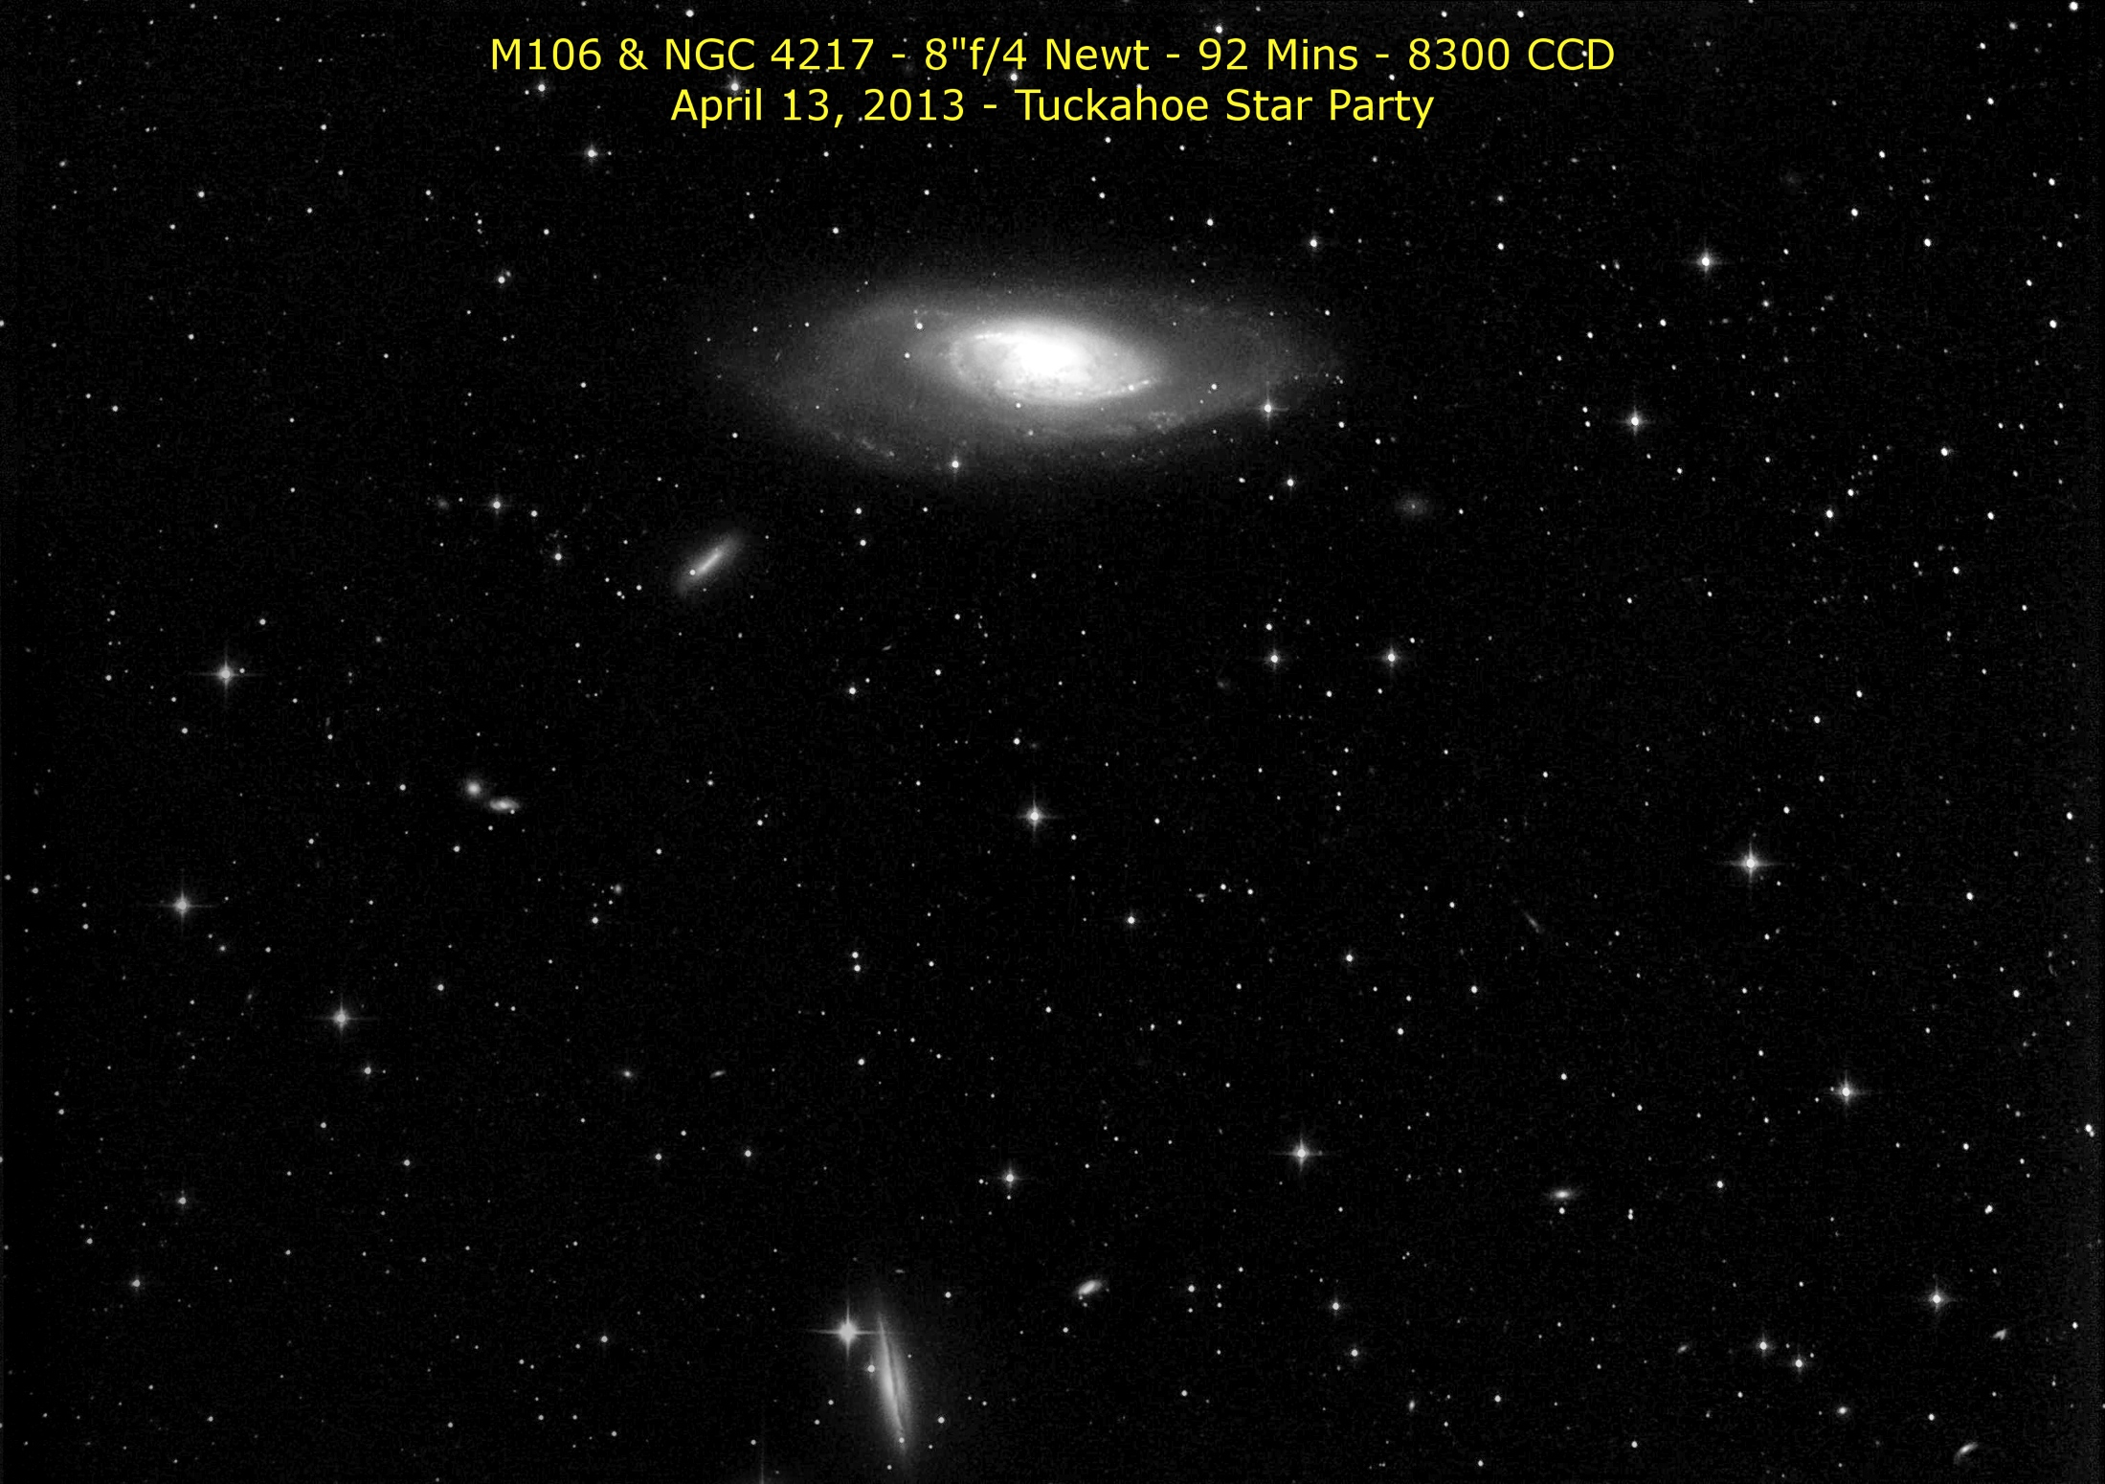
Gene Handler

Slide 17
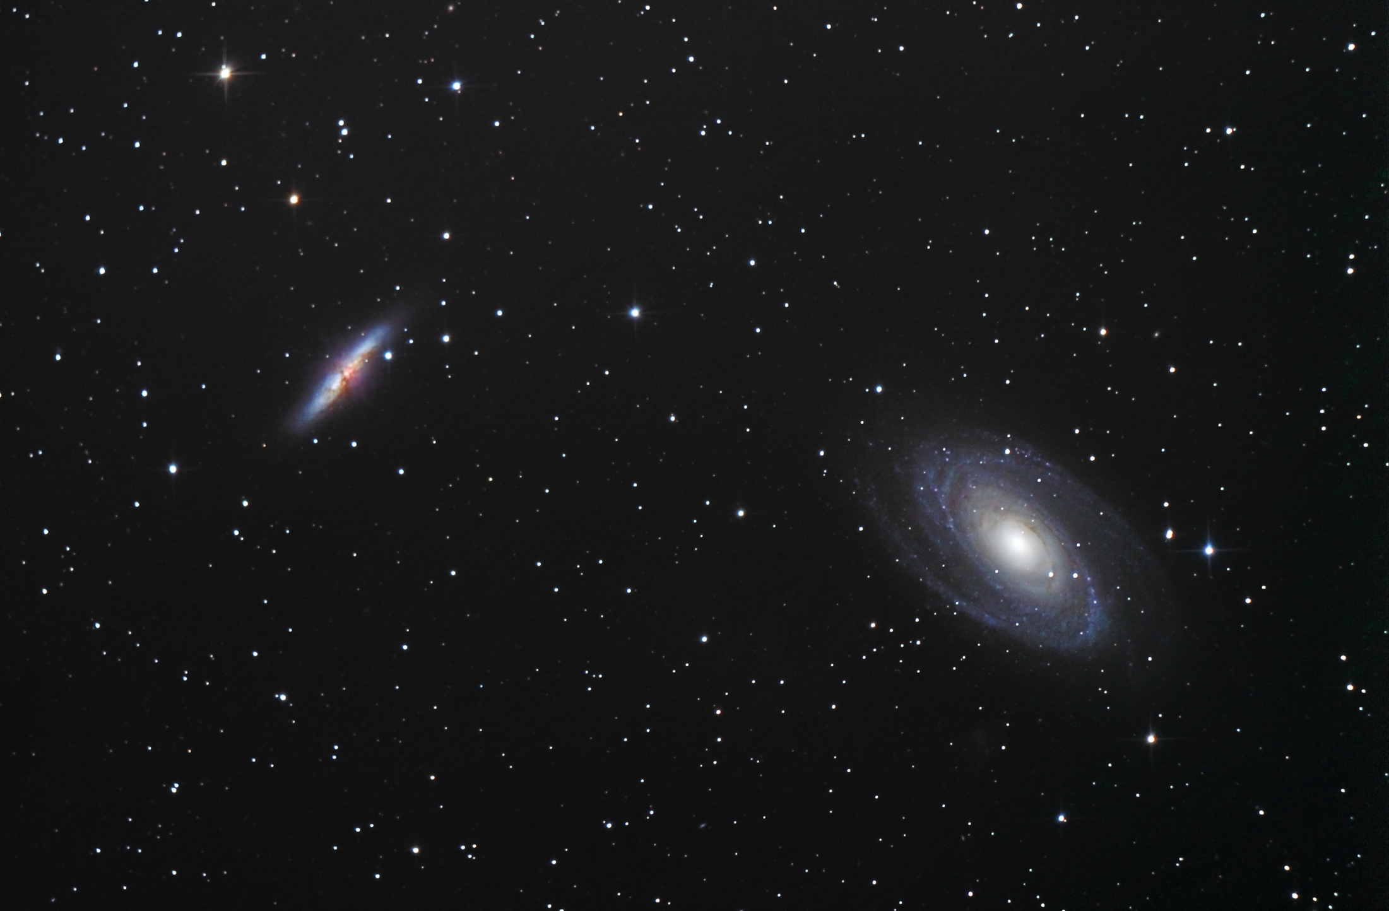
Carson O’Ffill

Slide 18
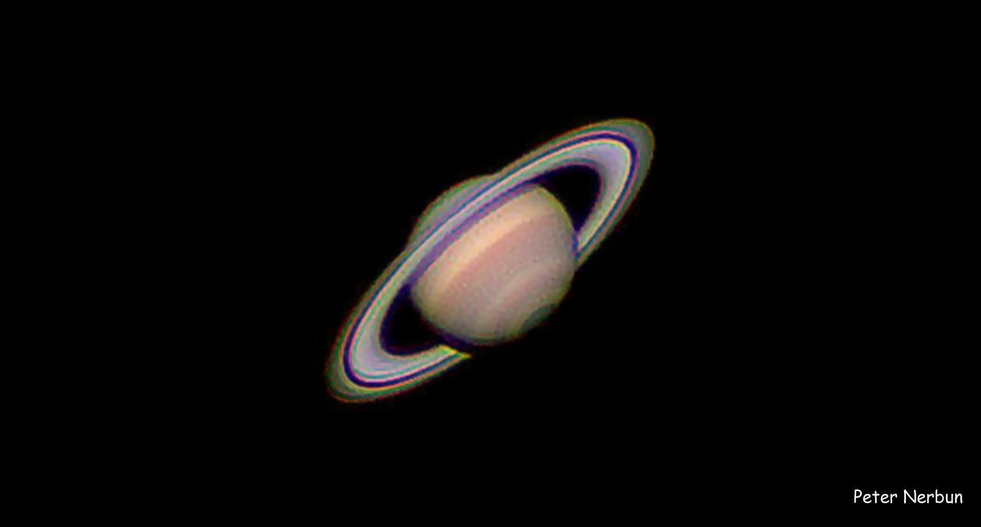
Peter Nerbun

Slide 19
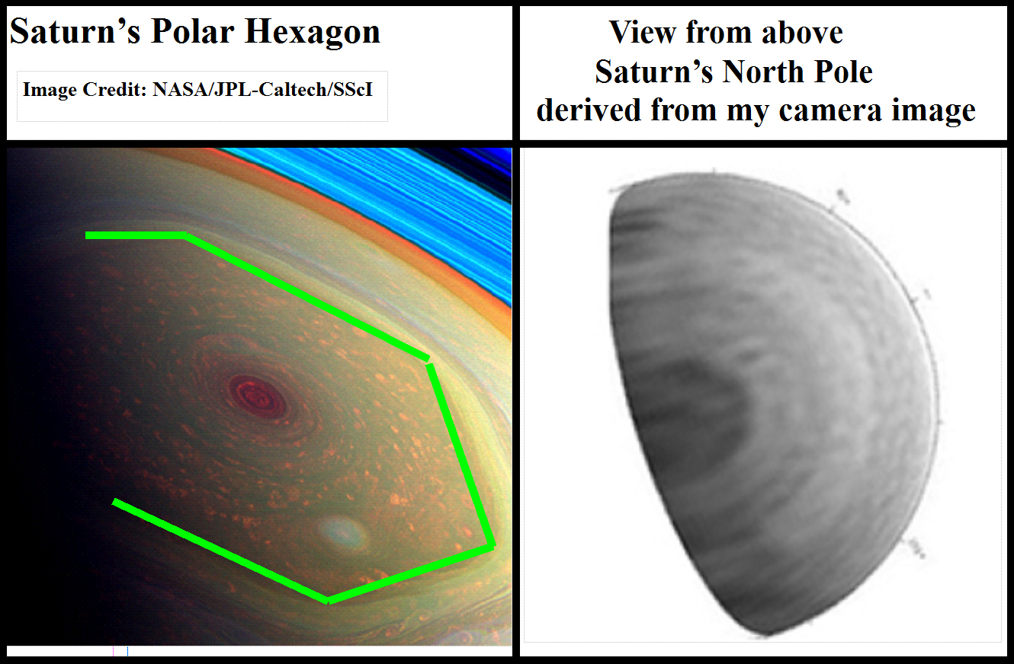

Slide 20
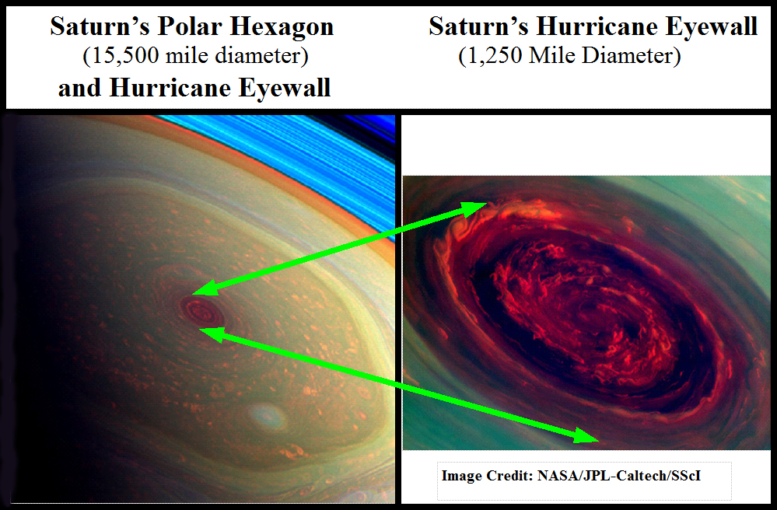

Slide 21
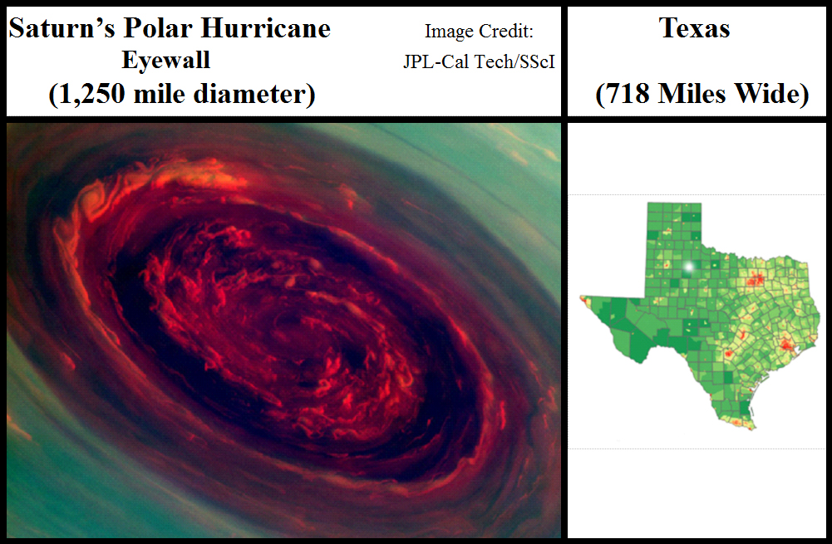

Slide 22
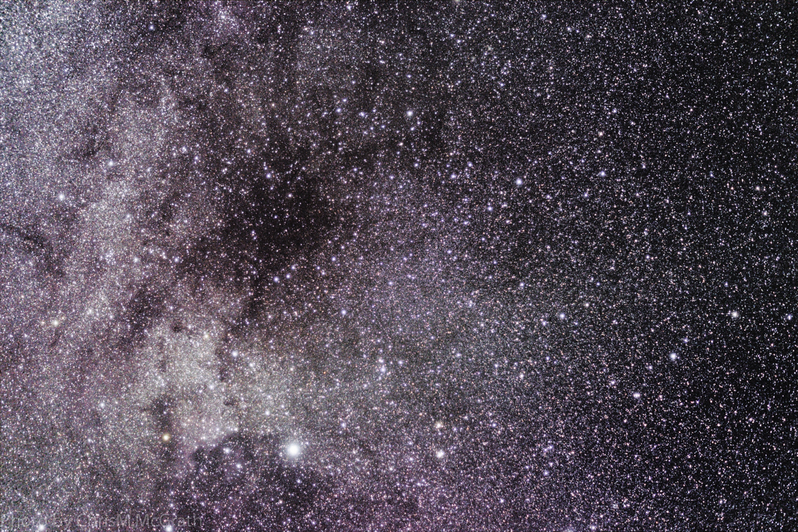
Chris McGrath

Slide 23
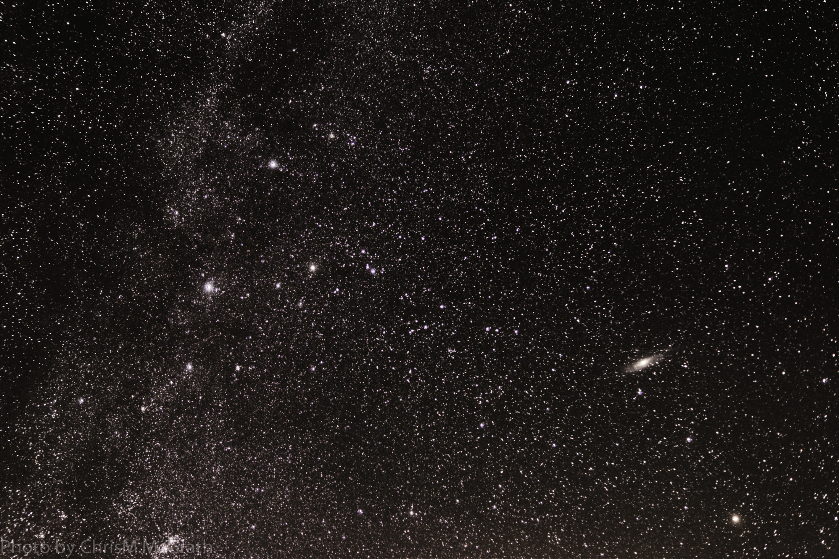
Chris McGrath

Slide 24
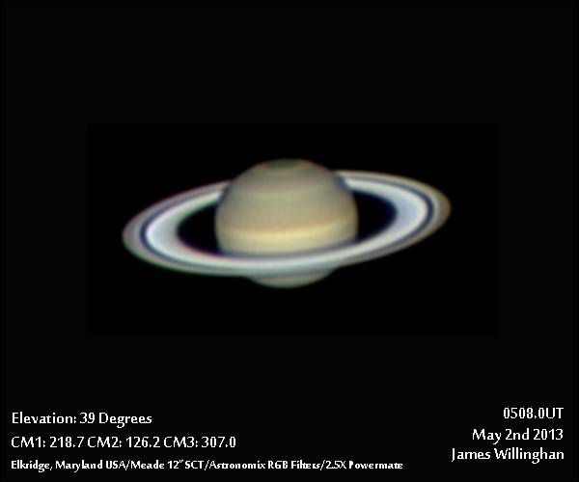
James Willinghan

Slide 25
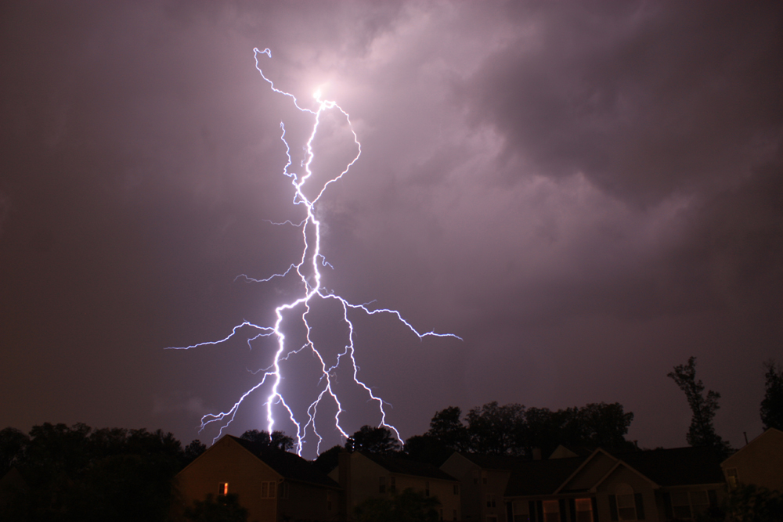
James Willinghan

Slide 26
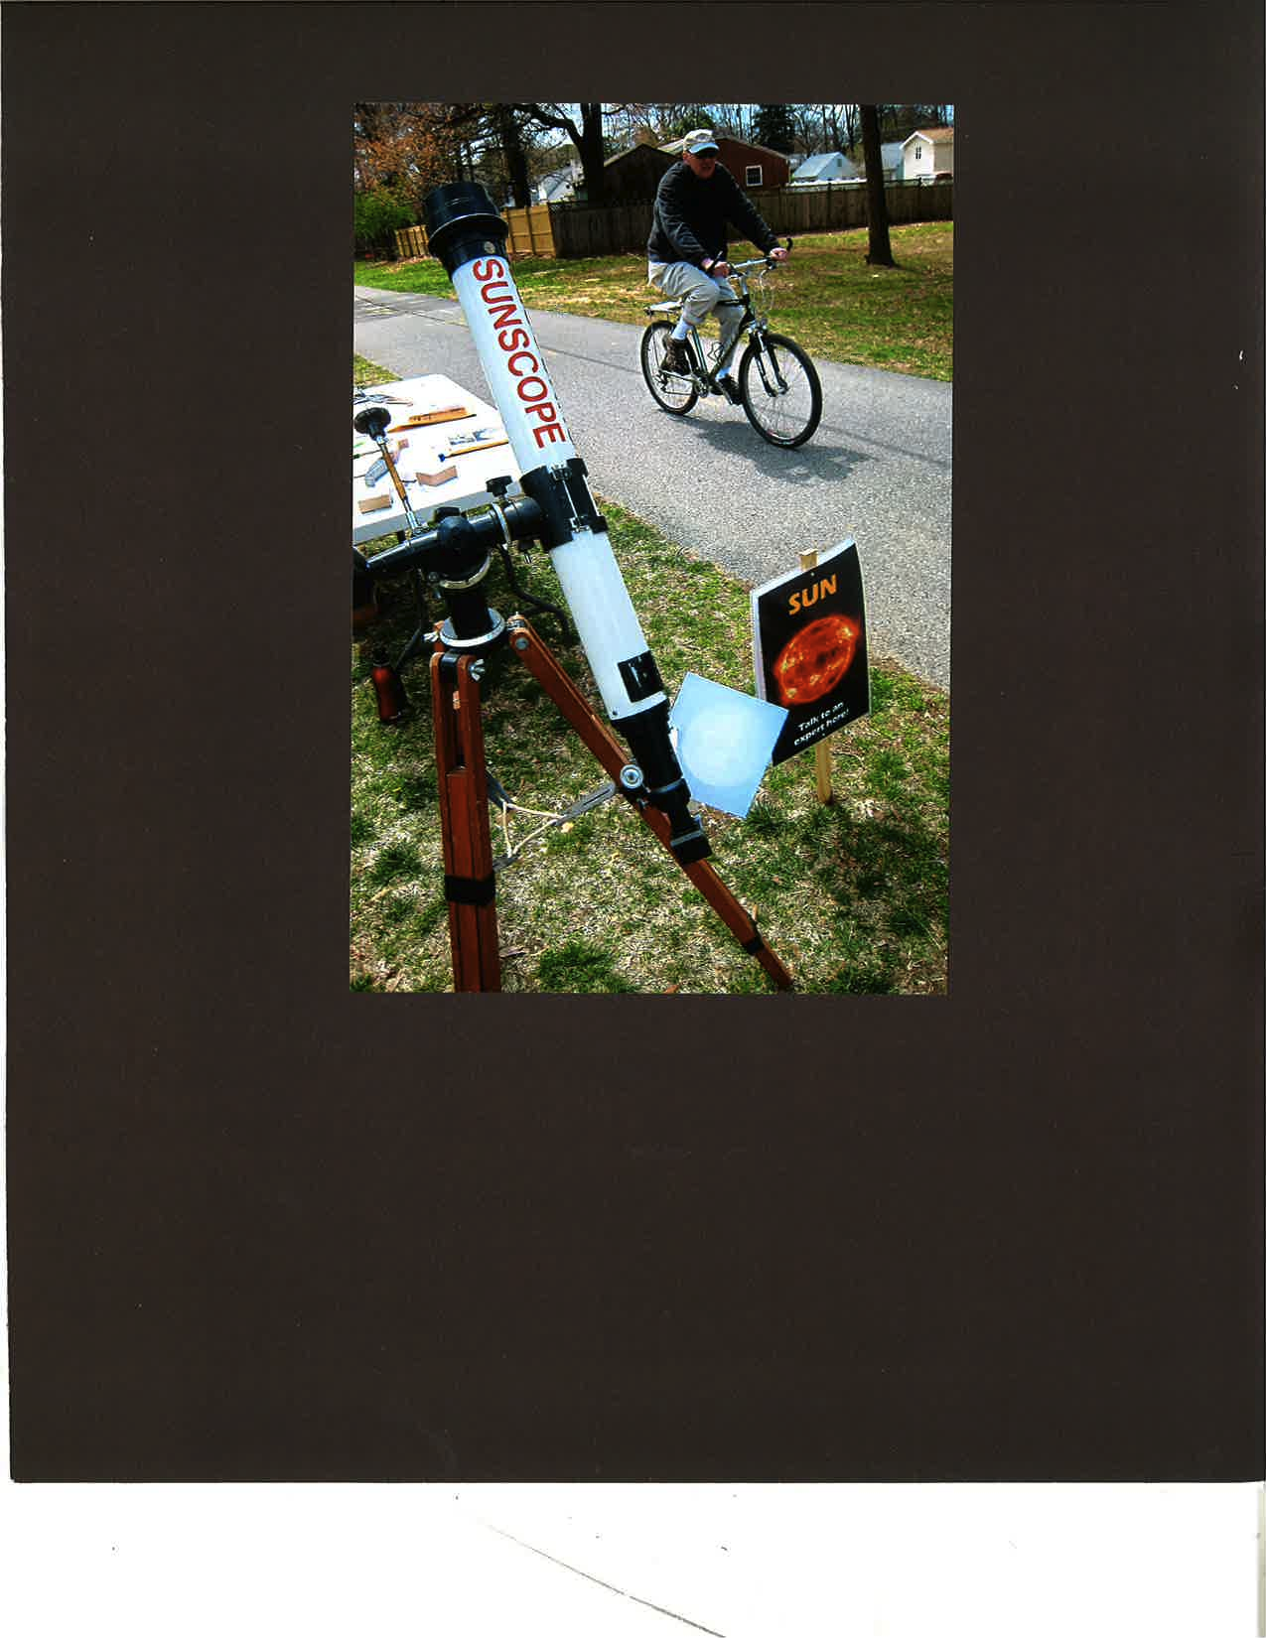
Herman Heyn

Slide 27
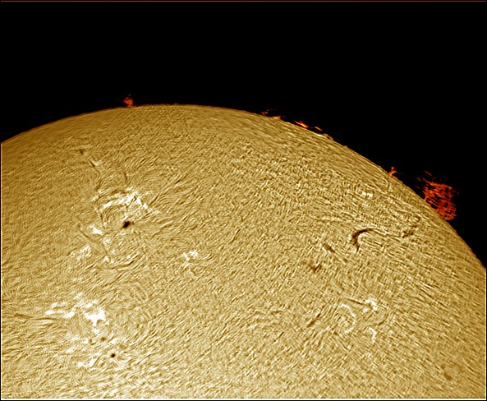
James Willinghan

Slide 28
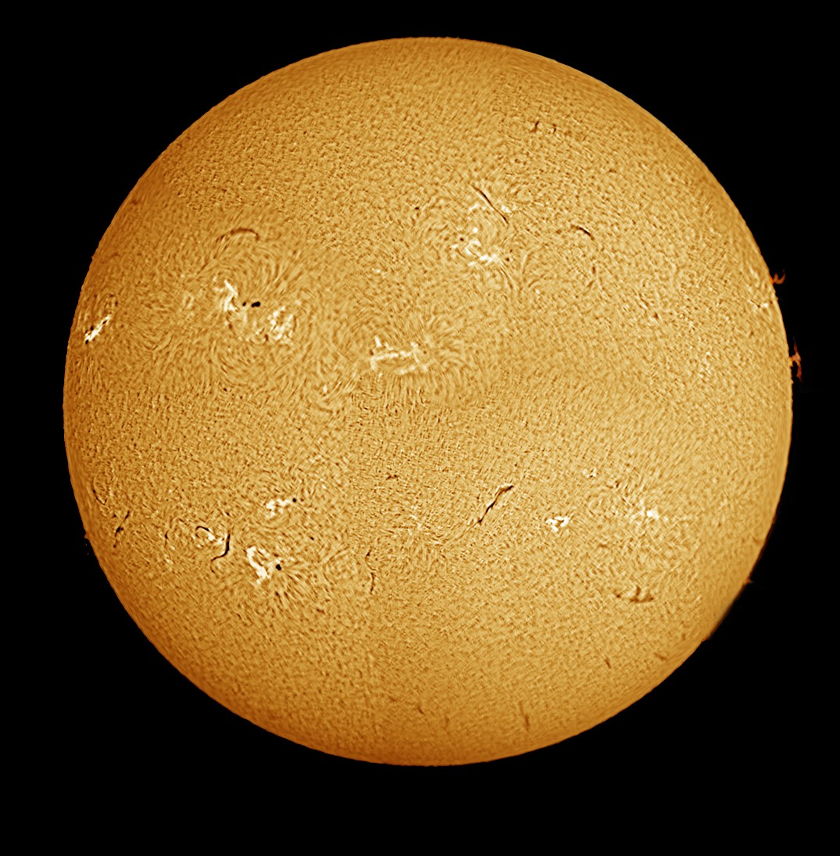
James Willinghan

Slide 29
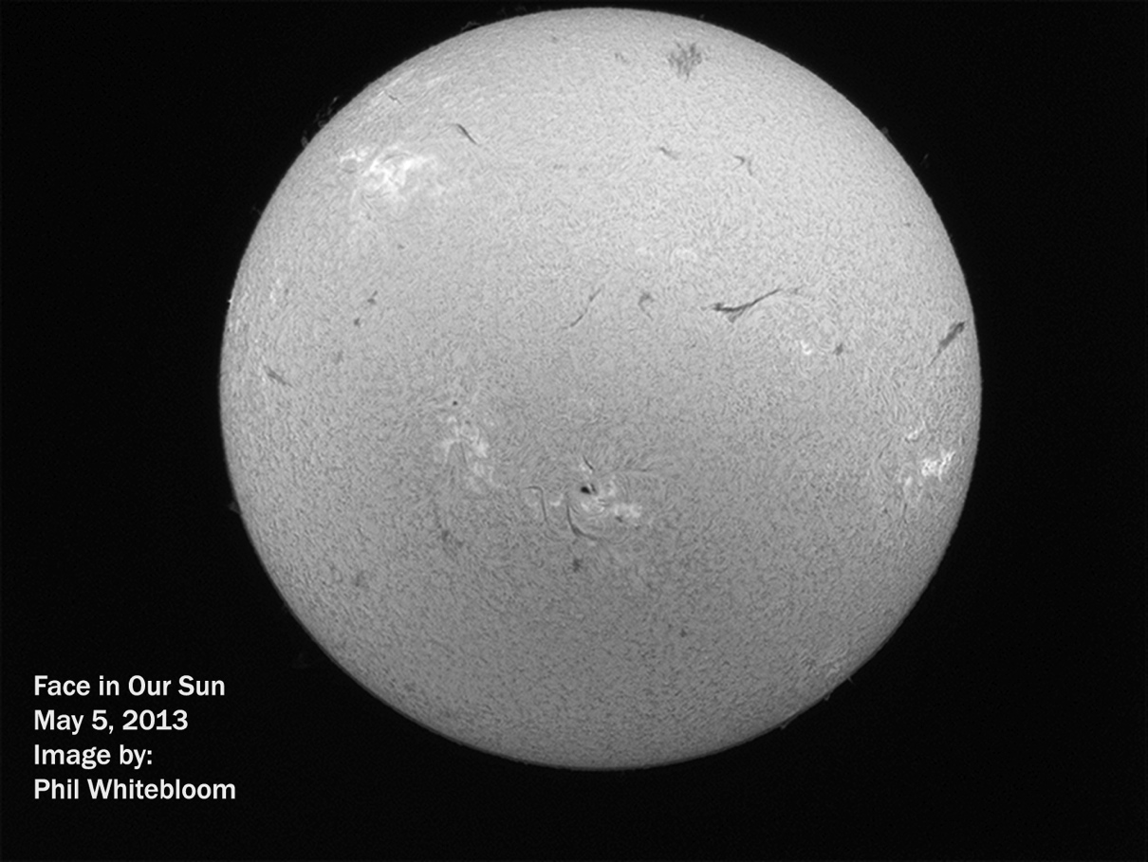

Slide 30
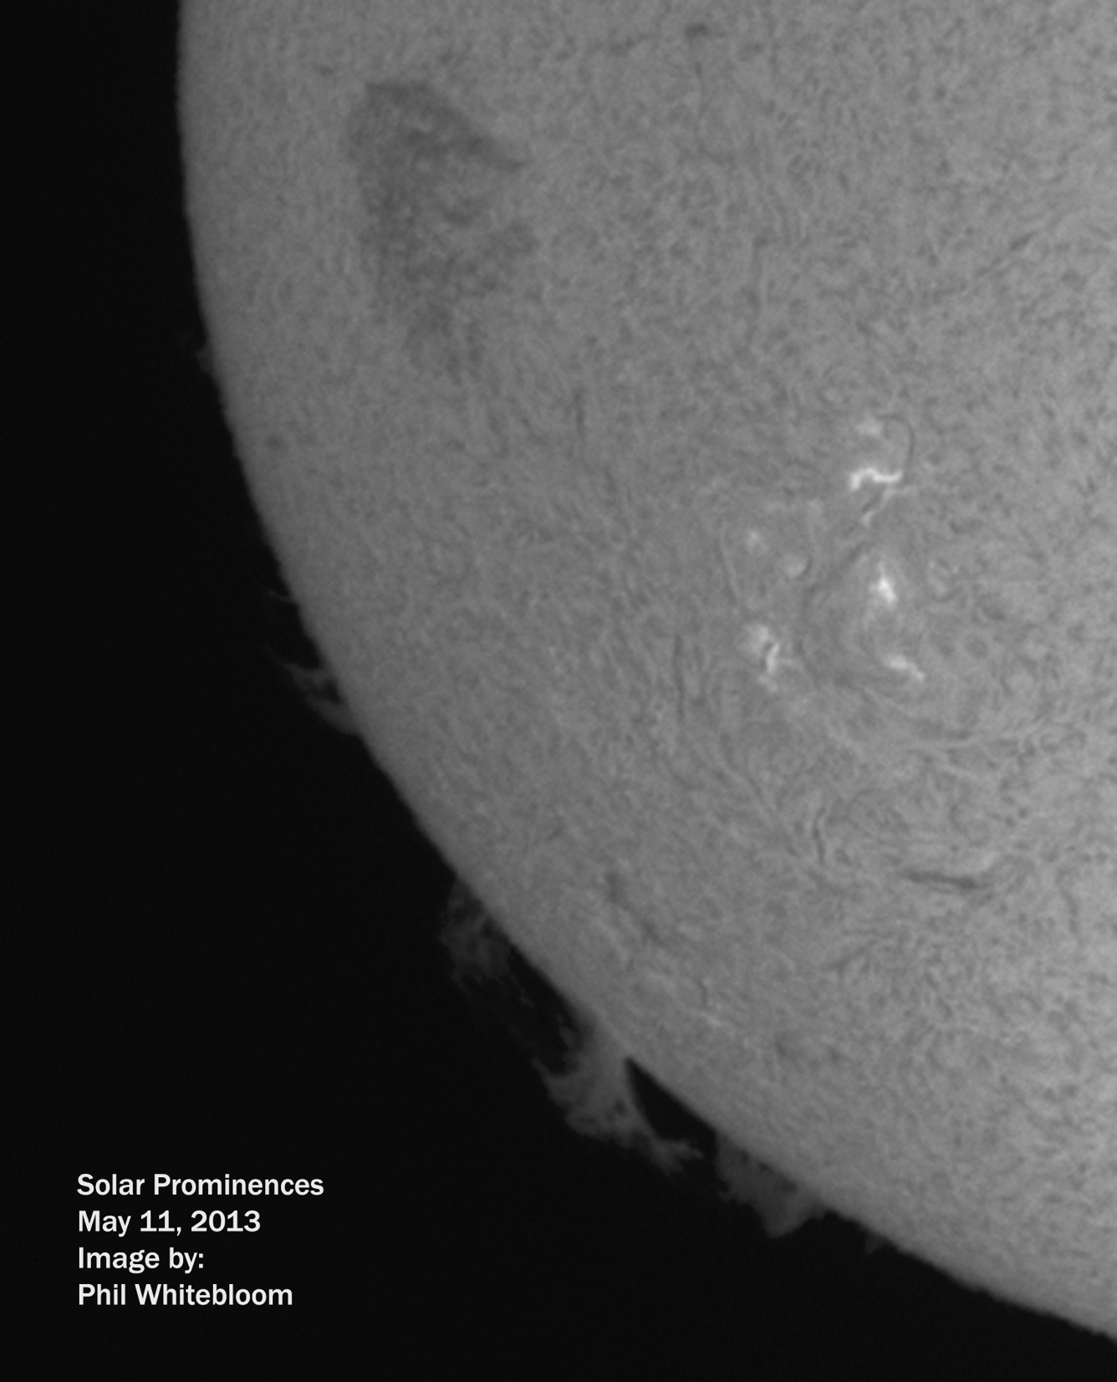

Slide 31
Stumper answer

Slide 32
Nicolas Louis de Lacaille divided Argo Navis into three constellations.
Name them.
Carina (the Keel),
Puppis (the Poop deck),
and Vela (the Sails)

Slide 33
Thank You!
Next month’s meeting is on Thursday,
June 20, 2013
7:30 PM
Guest speaker:
Me!
“So you wanna attend a regional star party?

